Slide 1
When the World is White
Mary Wilby, PhD, CRNP
La Salle University
Philadelphia, PA , USA

Slide 2
When this paper was written in 2009
Raise awareness about racial and ethnic disparities in American nursing and nursing education.
Recognize Eurocentricity as a factor influencing nursing education & practice
Address specific problems nurses can act on to reduce disparities.

Slide 3
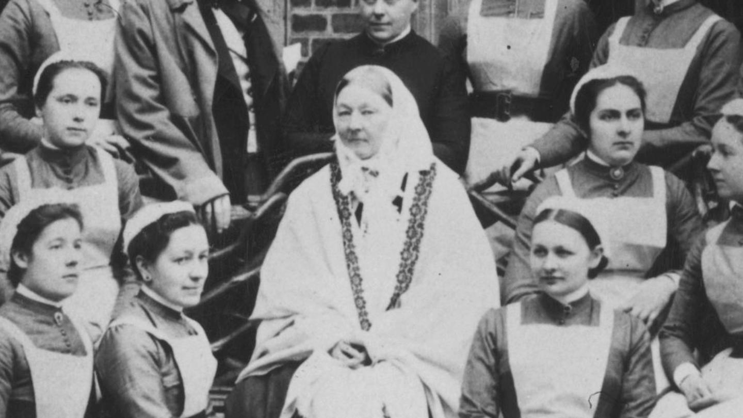
A predominantly white, female profession

Slide 4
A predominantly white, female profession
According to the U.S. Census Bureau, individuals from ethnic and racial minority groups accounted for more than one third of the U.S. population (38%) in 2014.
A 2017 survey conducted by the National Council of State Boards of Nursing (NCSBN) and The Forum of State Nursing Workforce Centers, nurses from minority backgrounds represent 19.2% of the RN workforce.
Racial and ethnic backgrounds of U.S. RN population include 80.8% White/Caucasian; 6.2% African American; 7.5% Asian; 5.3% Hispanic; 0.4% American Indian/Alaskan Native; 0.5 Native Hawaiian/Pacific Islander; 1.7% two or more races; and 2.9% others. The survey also found that men now account for 9.1% of the RN workforce.
AACN.(2019).Enhancing diversity in the nursing workforce fact sheet.

Slide 5
Cultural Competence??
Ability to care competently for others from cultures other than one's own.
How do we care for and work with students & each other?
Is our point of view too Eurocentric?
Does curriculum reflect the perspective of non-majority students?
How can professional nursing & nursing education expand its view?

Slide 6
What have we done to address our practices with students & each other?
Recruitment & retention efforts- mixed success
Minority student attrition
Faculty diversity remains an unsolved issue.

Slide 7
Subtle forms of racism
Among white faculty & students
Education experiences difficult for minority students

Slide 8
Barriers to inclusivity
Barriers for minority students
Views of behavior, order, professionalism continue to shape modern nursing.
Discrimination from peers, faculty, & clinicians in classroom & clinical settings.
Absence of belonging
Barriers for nursing faculty
Recruitment, hiring, and retention
Appearance and speech patterns
Search committee members more likely to hire those like them
Minority faculty have less influence in decision making
Need for opportunity, resources, support
Metzger, m. et al. (2019). Inclusivity in baccalaureate nursing education: A scoping study. Journal of Professional Nursing, 36, 1 , 5-14.
Salvucci, C. & Lawless, C, (2016). Nursing faculty diversity: Barriers & perceptions on recruitment, hiring & retention. Journal of Cultural Diversity, 23, 2, 65-75.

Slide 9
Advanced Education
A 2008 National Sample Survey of Registered Nurses conducted by HRSA found that RNs from minority backgrounds are more likely than whites to pursue baccalaureate and higher degrees in nursing.
While 48.4% of white nurses complete nursing degrees beyond the associate degree level, the number is equal or greater for minority nurses; African American (52.5%), Hispanic (51.5%), and Asian (75.6%) nurses.
RNs from minority backgrounds clearly recognize the need to pursue higher levels of nursing education beyond the entry-level.

Slide 10
White Privilege
White privilege, an advantage of which most white people are not consciously aware, refers to the unearned benefits of wealth, power, and status gained at the historical and current expense of people of color.
White nurses engaging in conversation about white privilege can raise consciousness and enable white nurses to speak up and hold each other accountable for consciously & unconsciously contributing to marginalizing others.
Hall, J & Fields, B. (2013). Continuing the conversation in nursing on race & racism. Nursing Outlook. 61, 164-173.

Slide 11
Whiteness and difference
Whiteness= dominance, status, privilege
Is "acting white" necessary for professional survival?

Slide 12
Can we link theories of culture and theories of caring?

